Slide 1
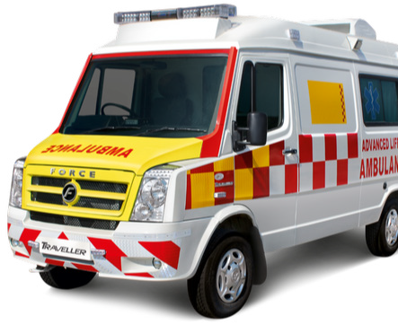
VAISHANAVI SHIKSHAN PRASARAK VAA BAHUUDDESHIY SANTHA KHAMGAON DISTRICT BULDHANA
REGSTRATION MH/6275/2001
CONTACT NUMBER 9423749600/9518565380
At Vaishnavi Shikshan Prasarak VA Bhahuuddeshyia Sanstha (वैष्णवी शिक्षण प्रसारक व बहुउद्देशीय संस्था), we’ve been a beacon of hope since 2001, working tirelessly for a healthier, more prosperous society. Our motto, “For the people, by the people,” is the heartbeat of our mission. Our projects include an initiative to enhance rural healthcare in Buldhana, Maharashtra, focusing on the underprivileged population of the district. Additionally, we’re introducing the “MOBILE HOSPITAL AND AMBULANCE SERVIES”committed to delivering top-tier healthcare and a wide range of medical services within a single, state-of-the-art facility, ensuring convenient and high-quality healthcare for all.

Slide 2
Index :
Concept Note
Need to do this project
Guidelines for scaling the project
Minimum requirement to start the mobile dispensary Seva.
List of Medicines and Equipment’s.
Human resources
Rules & Regulations :
Process for operating the van
Announcement details for the announcer.
Role of Vaishnavi trust Head office.
Leaflets
Press note matter
Format to be filled by the volunteers.
Finance analysis with road map to run Long terms
Contact Details And recipient

Slide 3
Concept
The vsps serving in the field of medical field from last last 3 decade:
**Project Proposal: Mobile Dispensary and Ambulance Service for Underserved Communities**
**Introduction:**
In a world where access to healthcare remains a fundamental human right, countless individuals in underserved rural areas continue to face tremendous barriers to receiving essential medical care. Today, we announce our ambitious initiative to launch a Mobile Dispensary and Ambulance Service aimed specifically at the underprivileged populations in our local villages, ensuring no individual is left behind in their time of medical need. With over three decades of dedicated fieldwork in community healthcare, we are poised to transform the health landscape for the poor and needy in our geographic area.
**Project Overview:**
The primary goal of our initiative is to provide timely and accessible medical services to the most vulnerable members of our community. Many residents in these remote villages lack reliable transportation or nearby medical facilities, sometimes delaying urgent care by hours or even days. Our project seeks to remedy this critical gap by offering a mobile dispensary combined with an emergency ambulance service.
**Key Features of the Service:**
Our mission is driven by compassion and a strong commitment to social equity in health care. With the launch of the Mobile Dispensary and Ambulance Service, we aim to be a beacon of hope for those who have been neglected by traditional medical infrastructures. But to bring this vision to reality, we need the support of compassionate individuals, local businesses, and grant organizations dedicated to health care equity.
Join us on this vital journey to eradicate the health disparities faced by our local communities. Together, we can make healthcare a universal promise reached for even the most marginalized populations. Let’s create a healthier, happier, and more equitable tomorrow for everyone.
PROJECT INCHARGE :DR.SUREKHA K MENDHE
PRESIDENT OF TRUST
contact no ; 9423749600 /9518565380
a)
b)
.

Slide 4
Guidelines for Scaling the project :
  Initially, the scaling will be done in the Maharashtra, Tamilnadu, Karnataka, Delhi, Madhya Pradesh & Rajasthan. The statewise list of the state project Di rector will be provided with their names and mobile numbers. He will be the single point contact of that respective state with full responsibility.
  Vaishnavi Trust along with Social organisation or any other organisation of that par ticular city can be taken as local partner to initiate the project.
  All the specific guidelines for starting this project will be given by the state
project director.
Minimum requirement to start the mobile dispensary Seva :
  Two Ambulance or van like traveller can be taken or through sponsorship.Which can be equipped with all the necessary dispensary
  b) Two Ambulance with small size would be available for transport of Emergency patients from remote area to higher centre at chip rate
  c) 6 doctor and 8 assistant 6 driver 3 cleaner will be required per mobile dispensary Hospital and Ambulance Services Project
Note : The doctor can be taken with the help of the local administration, privete practioner’s..
  1 cleaner per van either from Vaishnavi Trust , any local person from your city or you can call any teacher by contacting their trustees and informing them that un der the Disaster management act they can avail the services of their teachers.
  Loud speaker for announcements.
  Providing food for the doctor and other staff.
5. List of medicines and Equipment :
Every Ambulance will be well equipped with Medicines, equipment’s, doctor, assis- tant and a Volunteer. Per Ambulance requirements :
Medicines :
Tab paracetamol : 2000
Tab cetrine : 1000
Tab diclopara : 500
Tab pan 20mg : 2000
Tab meftal spas : 500
Tab loperamide : 500
Tab salbutamol : 500
Tab prednisolone 10 mg :500
Tab b’plex : 2000
Tab metrogyl 400 mg : 1000
Eye drops gentamicin : 50 12)corex-dx syrup : 200 bottles.
Equipments :
stethscope : 1
BP apparatus : 1
Laser Infrared thermometer : 1
Torch : 1
Tongue depressors dispos- able 500 or s.s : 5
PPE for the working staff inside the ambulance : 4
Face masks (N-95) : 5
Writing pads : 4
Pens :4
Small paper envelopes for medicines :1000
Folding bed with pillow for patient and bed sheet
Small table :1
Folding chairs : 2/3
Hand wash or sanitizers
Dettol small bottles : 2
Plastic kidney tray :1
Dustbin :1
Drinking water with glasses
Napkins : 2

Slide 5
Human Resource’s :
  Doctor 6
  Assistant :8
  Cleaner : 3
  Driver with the Ambulance; 6
Note : The state project director will be requesting the local administration to provide doctors with their safety kit.
The safety of doctors and volunteers will be of utmost importance and will be taken care properly.
Rules & Regulations :
Follow properly the government norms of social Workers as well as follow the guidelines issued by the local authorities.
Process for operating the mobile van :
  Fix the location after discussing with the local authorities.
  Opening of the dispensary by the hands of your local Corporation Commis sioner or Collector and then start moving to various places.
  Chairs will be placed at a distance of 2 feet for the patients coming for check- up. After check-up they will be given the required medicines.
  Volunteers will be announcing as speakers.
Announcement details for volunteer :
  A mobile dispensary has arrived at your doorstep with the help of Vaishnavi trust
  This dispensary is made available for those who are having mild illness but cannot visit their family doctor.
  This dispensary does not have facility for orthopaedic treatment.
  5 chairs will be kept in front of the Van and patients sitting on these chairs will
be taken for check-up on first-cum-first basis.
  Only 1 person will be allowed with the patient. Also they should ensure that they are properly masked either with a handkerchief or a mask.
  This mobile van is equipped for illness like stomachache, throat infection, cough, cold and fever. After check-up medicines for 3 days will be given to the patients.
  Everyone should ensure that they do not mess up with people.
  Under the present seniors everyone should ensure proper discipline and keep safe distance from each other and take the benefit of this facility.

Slide 6
Role of VAISHNAVI TRUST Head Office :
  All the design required for display material will be provided. From your side you can then add the logo and the name of the local sponsorer or organisa tion along with Vaishnavi Trust name.
  The HO will be providing the help required in obtaining all the various permis sions in consultation with the project Director.
  We will be sharing our Khamgaon experiences of MENDHE Multispecialty Hospital alongwith some Videos for your con vienience and comfort.
Leaflets :
“Doctor at your door step”through Mobile dispensary van Seva :
Vaishnavi trushas launched in khamgoan City the mobile dispensary van wherein the Doctors will be at your door step.
Doctor at your door :
  During the lockdown, this service will be available to patients who have minor illnesses but cannot go to your family doctor.
  Patients diagnosed with fever, cough, cold, sore throat, bodyache and nose bleeds will be given free medicines.
  On behalf of local authorities, medical examination of senior citizen in the city will be conducted through a total of 15 squads.
  Patients will be requested by loudspeakers at various places where the van is parked. Doctors will not come to anyone’s home during the investigation.
Precautions to be taken when checking:
Arrangement of Announcement has been arranged in this mobile van. Pa tients will have to leave their house for examination only after announcement.
Be careful not to crowd around the mobile van.
5 chairs will be kept at a 2-2 feet distance in front of the mobile van. The pa tient sitting on these chairs will be checked sequentially.
Patients who come for examination should wear a mask or handkerchief.
During the lockdown, everyone should ensure that this service is availed by keeping a safe distance.
If there is any doubt, please contact DR.SUREKHA MENDHE.(9423749600)
12. Press Note :
“Doctor at your door step”
Vaishnavi Trust has decided to implement the “Doctor at your Door step” program in our city with the help of ——— organisation through a mobile dispensary van. Vaishnavi Trust local vol- unteers will be there to assist you all the time.

Slide 7
Concept:
Due to lack of Medical facility across the country, people are unable to leave their homes and as such are unable to get access to their family doctors in their illness as all the dispen- saries are closed. Taking this into consideration, mobile dispensary vans have been arranged to provide doctor services for OPD patients. Senior citizens and poor class in the city will be inspected by a team of special doctors of our Municipal Corporation through the help of this Mobile Dispensary and Ambulance Service
This van will be rotated with the help of city’s Vaishnavi Trust in the densely populated places of the city. Announcement is arranged in this van. Patients will be requested by loudspeakers at various places in Khamgaon where the van is parked. Doctors will not go to anyone’s home during the investigation.
Minor illnesses like cold, cough, fever, runny nose and bodyache normally appears in many types of viral fever. In such circumstances the patient need not panic. They will be properly trained to take care of themselves and their community. Also during the medical examination if it is detected that a patient is having coronary symptoms then it will be easy tosuch patient immediately and prevent the spread and help re- duce the burden on the government medical care. At the same time it will be easy for the Goverment to collect patients information in this regard.

Slide 8
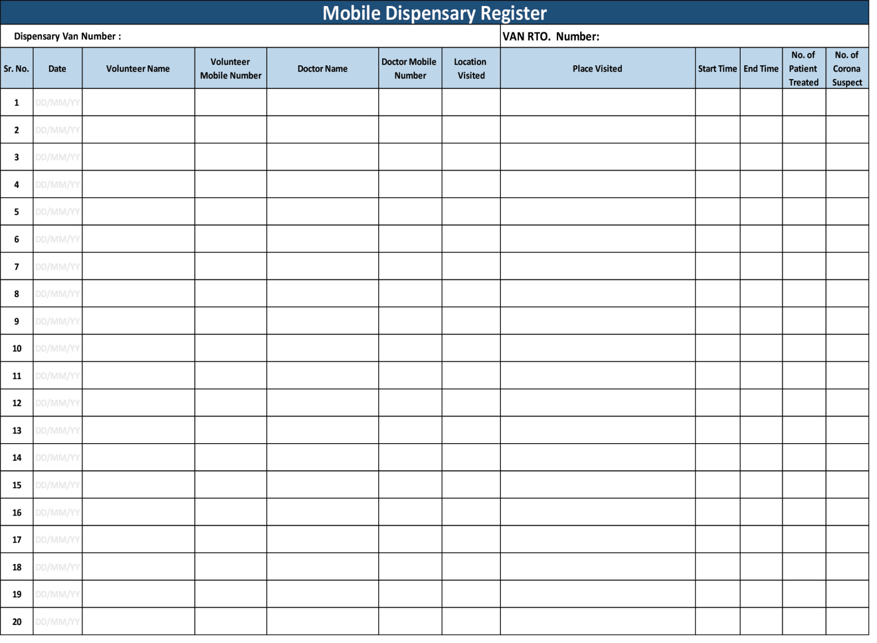
13. Format to be filled by the volunteers

Slide 9
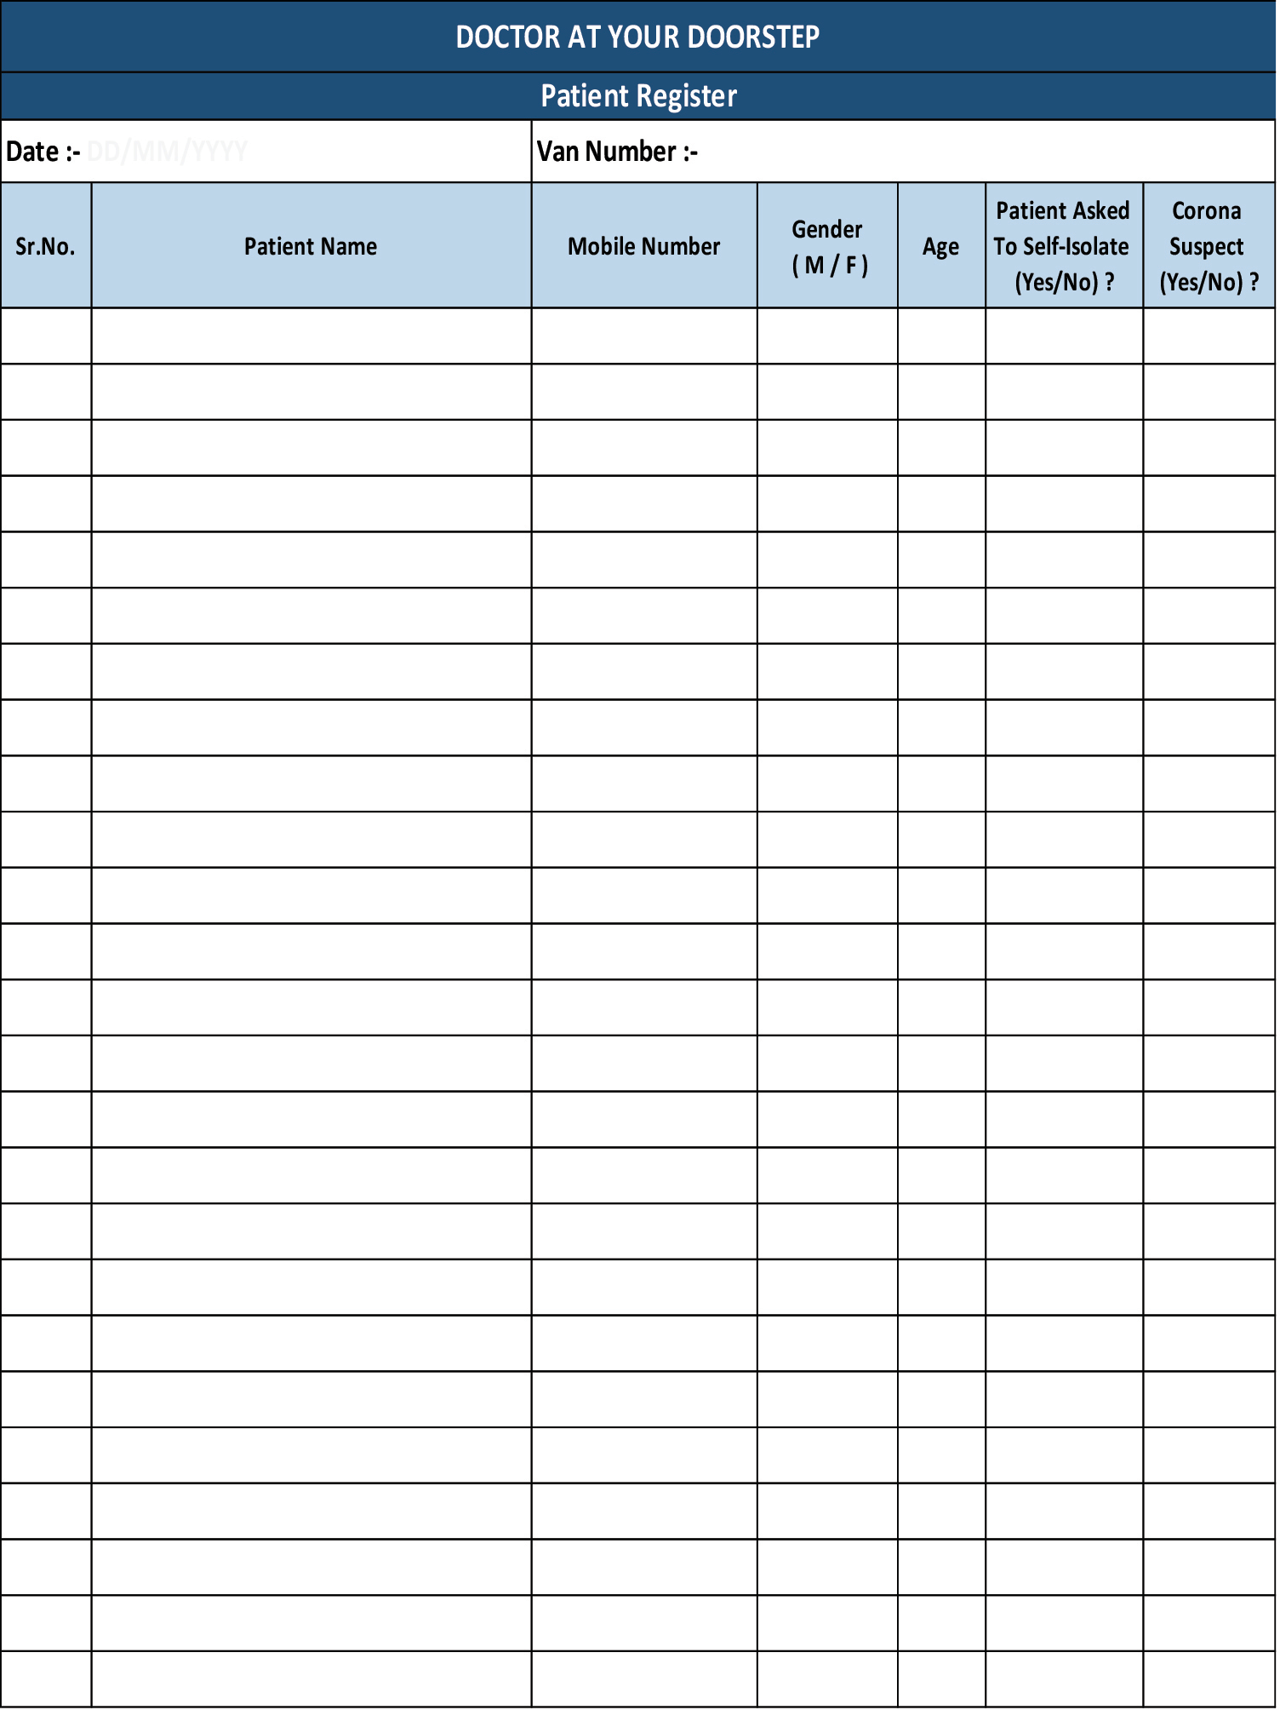

Slide 10
The financial for Vaishnavi trust project
The financial requirements for the project, which involves the Vaishnavi Shikshan Presarak VA Baheuueshiy Santa, include a 2-time investment. This investment will be used to acquire two tempo traveller ambulances equipped with mobile dispensaries, as well as EV2 routine ambulances for patient transportation at affordable rates. Additionally, there will be a need for a dead body transportation ambulance, exclusively for yellow card holders of states at a nominal rate. These investments are fixed for the project.
In terms of recurring income, the project will require funds for the monthly payments of six doctors, eight ANM staff, six drivers, and three cleaners. Other expenses, such as medicine, instrument changes, and vehicle maintenance, will also need to be accounted for.
To meet the financial needs, the project is seeking 70% of the required amount from a donor who will be acknowledged by having their name associated with the project. The trust will invest 20% of the required amount, and the remaining funds will be generated through charges imposed on the beneficiaries. Additionally, donations can be made through our website by individuals who wish to support this noble cause.

Slide 11
The financial requirement for the project are as Follows: FIX INVESTMENT FOR PURCHCHASE OF VECHICLES B) RECURING INVESTEMENT OF SALARY OF THE STAFF C) OTHER EXPENSES SUCH ARE AS FOLLOWS. A)
SR NO | VECHICLE TO BE PURCHASED | QTY | AMOUNTS
1 | 2 TEMOPO TRAVELLER AMBULANCE | 2 | 56,00,000
2 | 2 TRANSPORT AMBULANCE | 2 | 30,00,000
3 | 1 DEAD BODY TRANSPORTTER AMBULANCE | 1 | 14,00,000
 | TOTAL |  | 100,00,000
B) Recurring investment for the project
SR NO | SALARY OF EMPOLY OF THE PROJJECT | NUMBER | AMOUNT | TOATAL MONTHLY EXPENDITURE
1 | DOCORS | 6 | 1,20,OO0 | 2,40,000/MONTH
2 | DRIVER | 6 | 72,000
3 | ANM STAFF | 8 | 48,0000

Slide 12
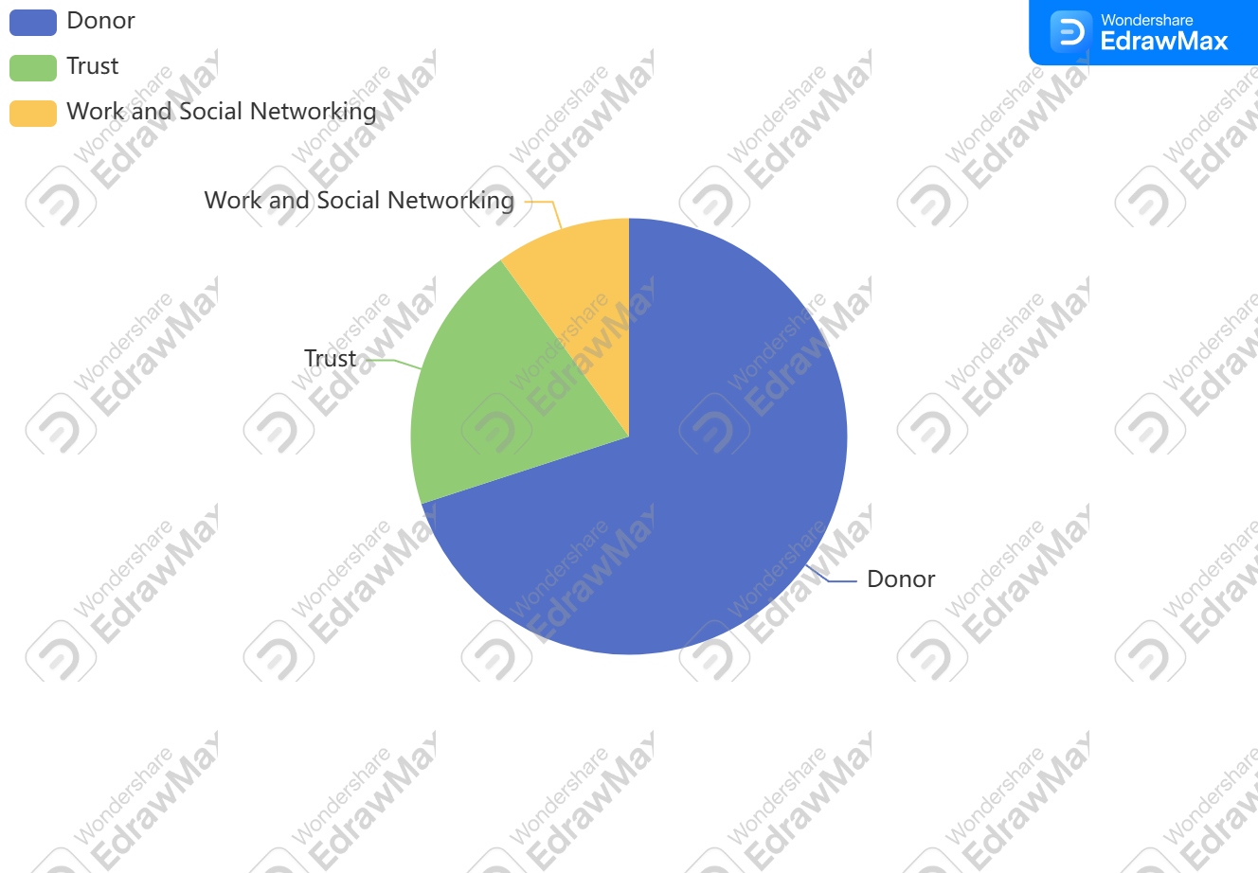
THE DISTRIBUTION THE PROJECT OF VAISHNAVI

Slide 13
THE FOOLWING LIST OF THE DOCUMENT OF TRUST AVIALABLE
REG CERTIFICATE
PAN CARD
TAN CARD
NITI AYOOG DARPAN
12AA CERTIFICATE
80 G CERTIFICATE
CSR 1 REGISTRATTION
Contact Details
Contact Info
MENDHE Hospital, Near Perm Residency, 1st Floor, Bhagat Singh Chowk, Khamgaon, District – Buldhana, State – Maharashtra, Pin code 444303
+91 9518565380 / 9423749600
WEBSITE :https://www.vaishnavishikshanprasarakvabahuuddeshiyasanstha.org
vicepresident@vaishnavishikshanprasarakvabahuuddeshiyasanstha.org
vaishnavishiskanparasaraksanth@gmail.com

